Slide 1


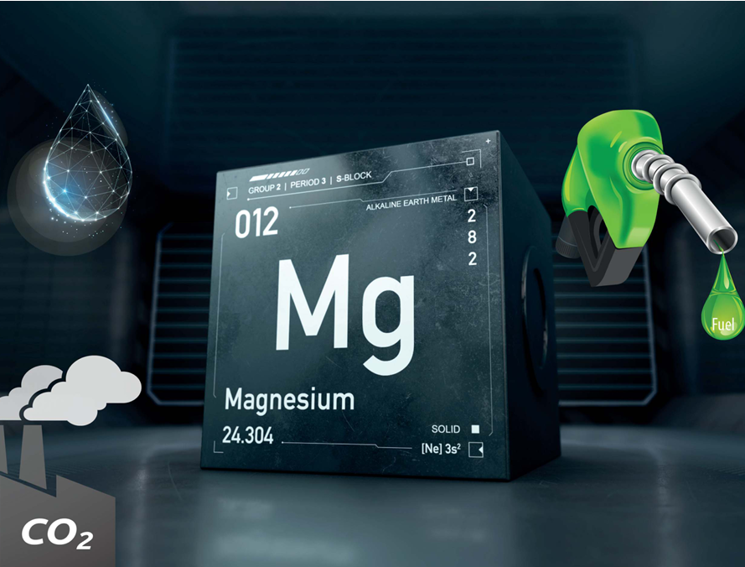
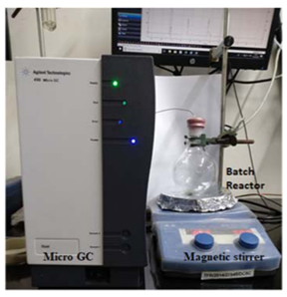
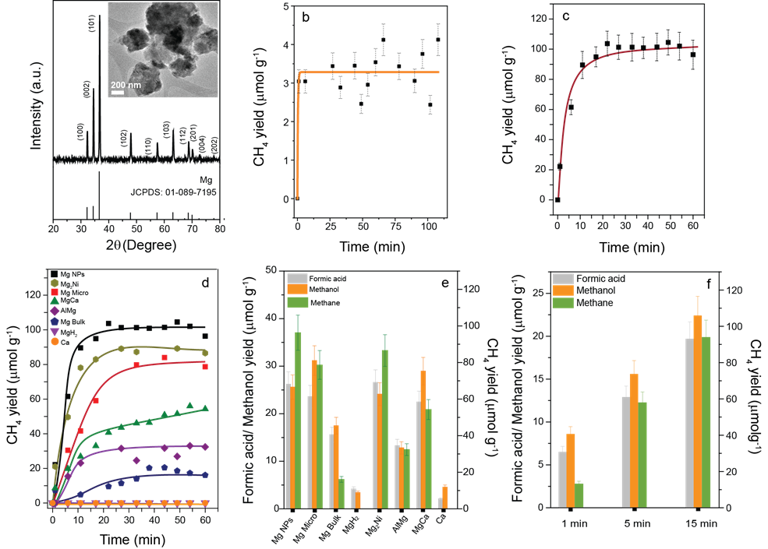
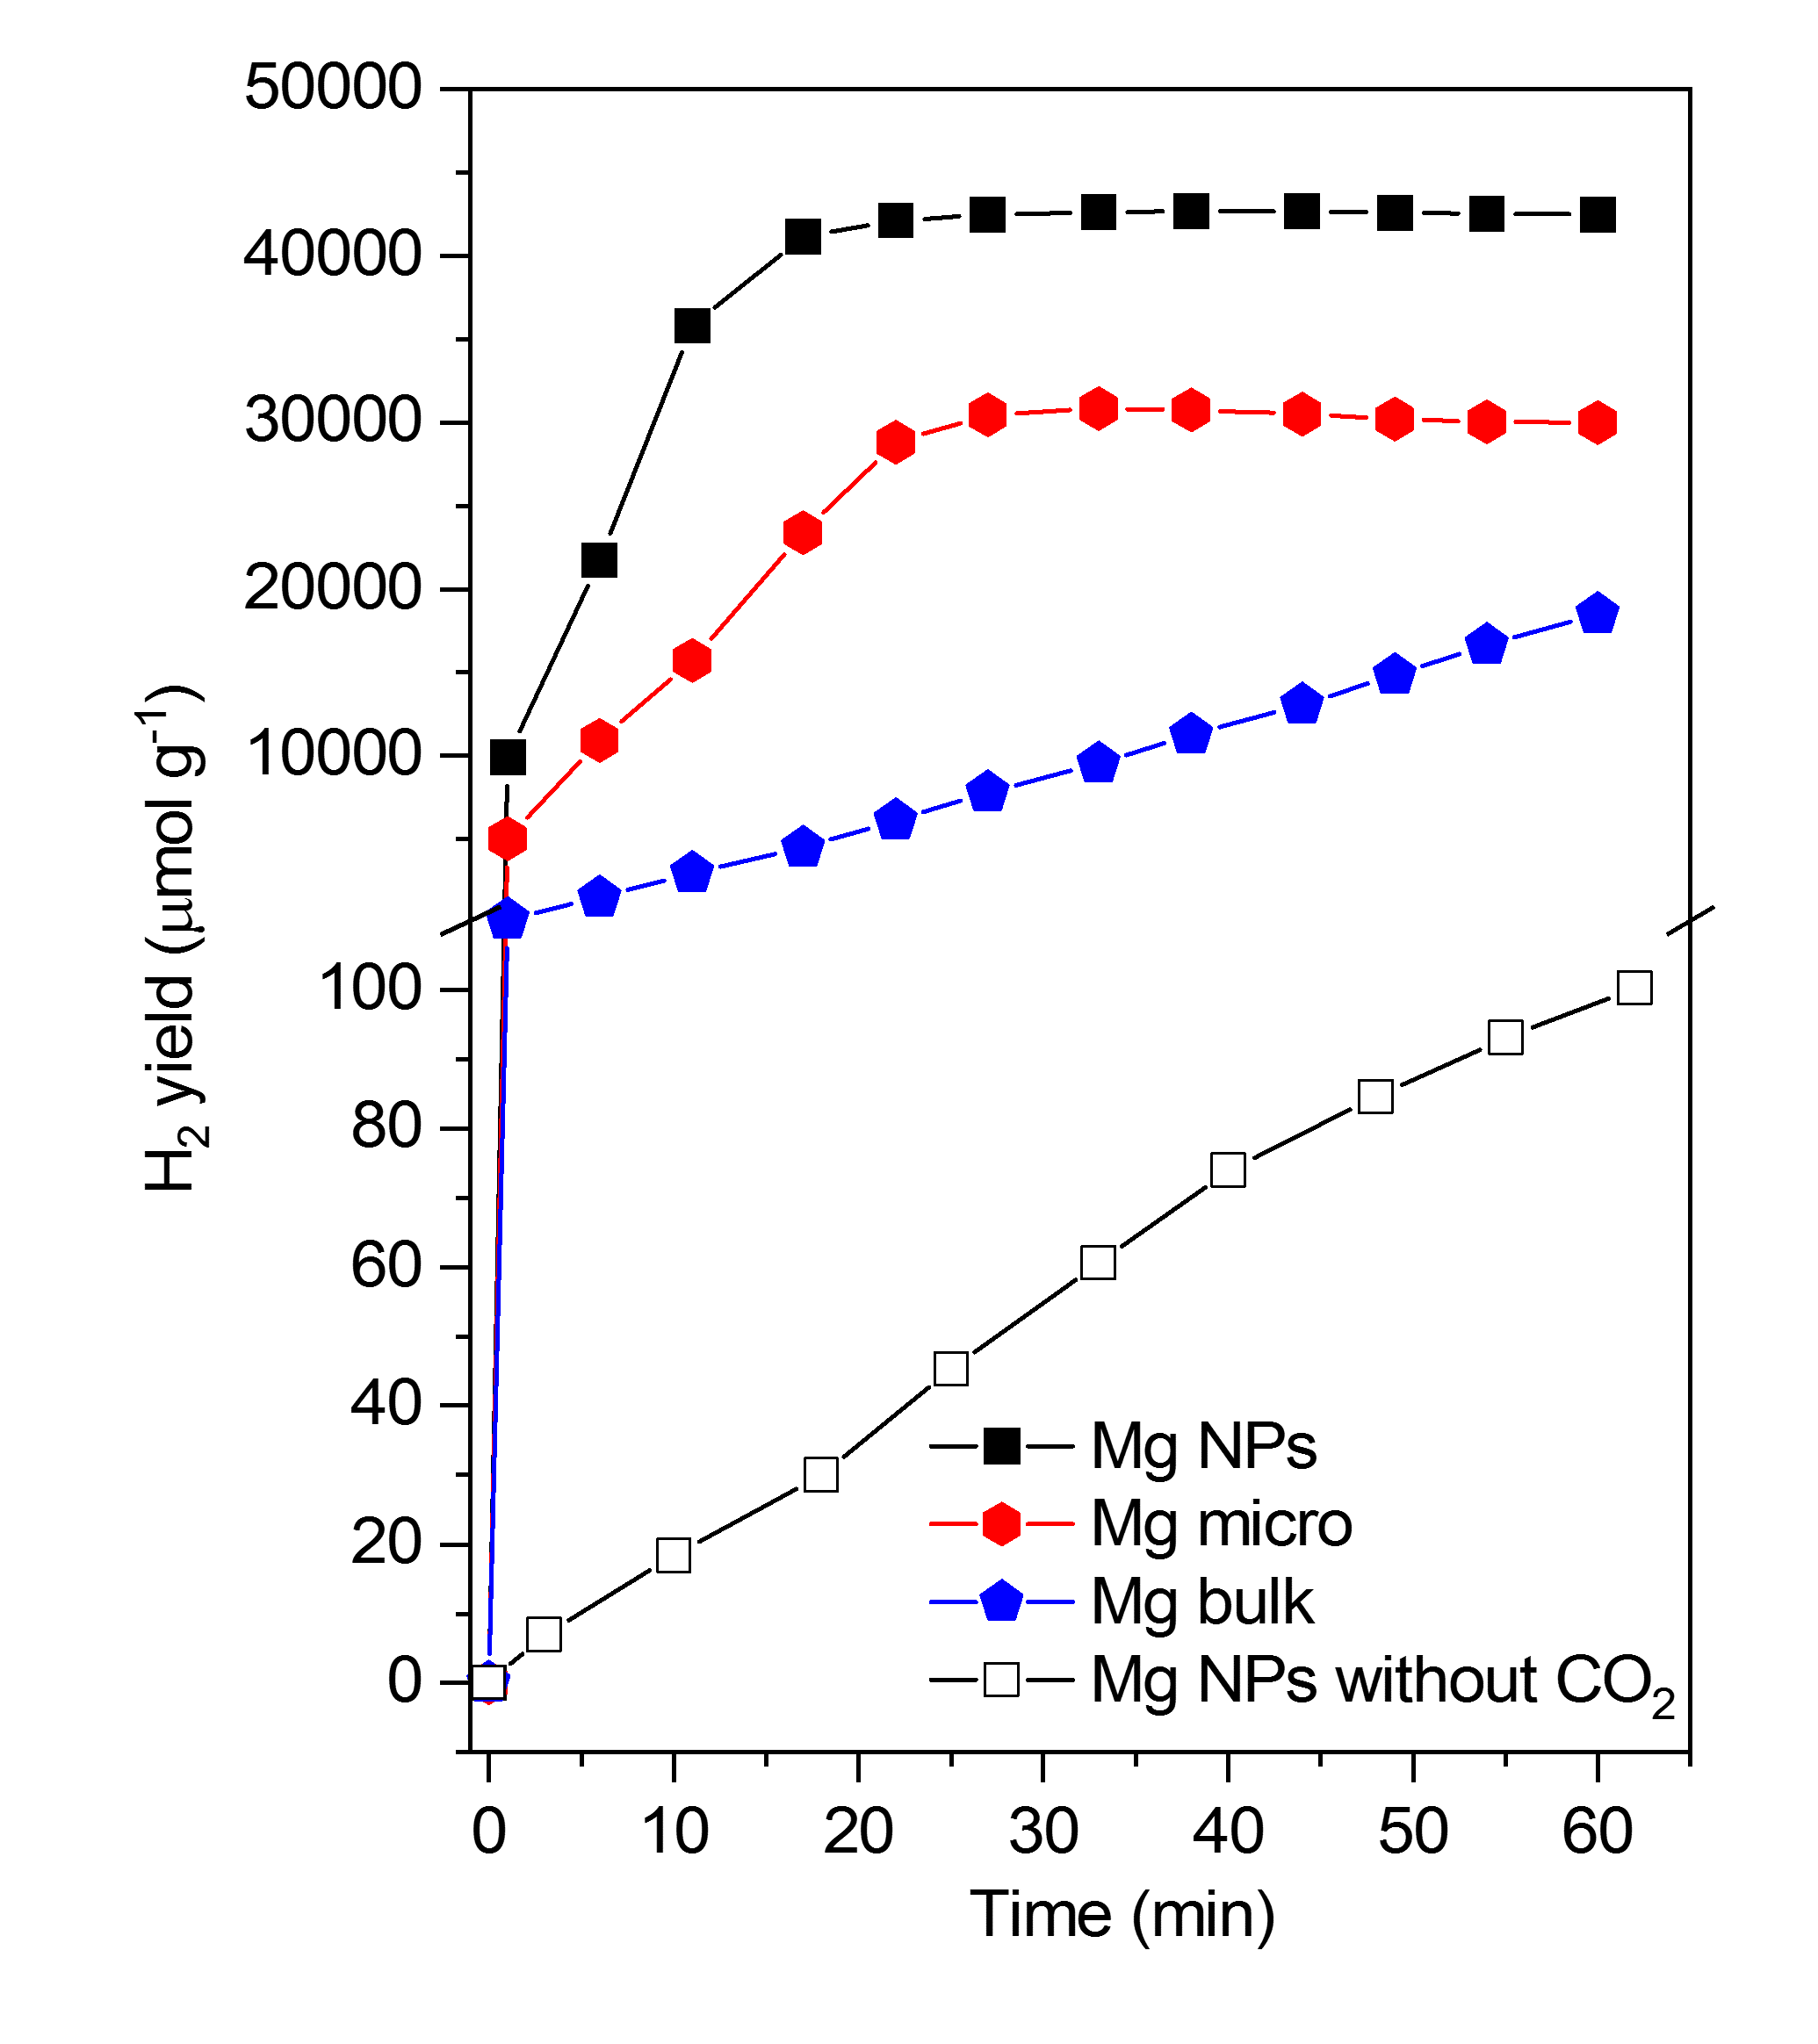
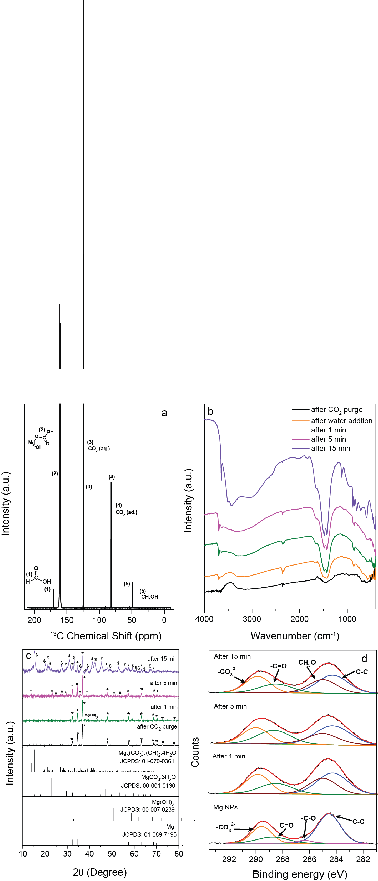
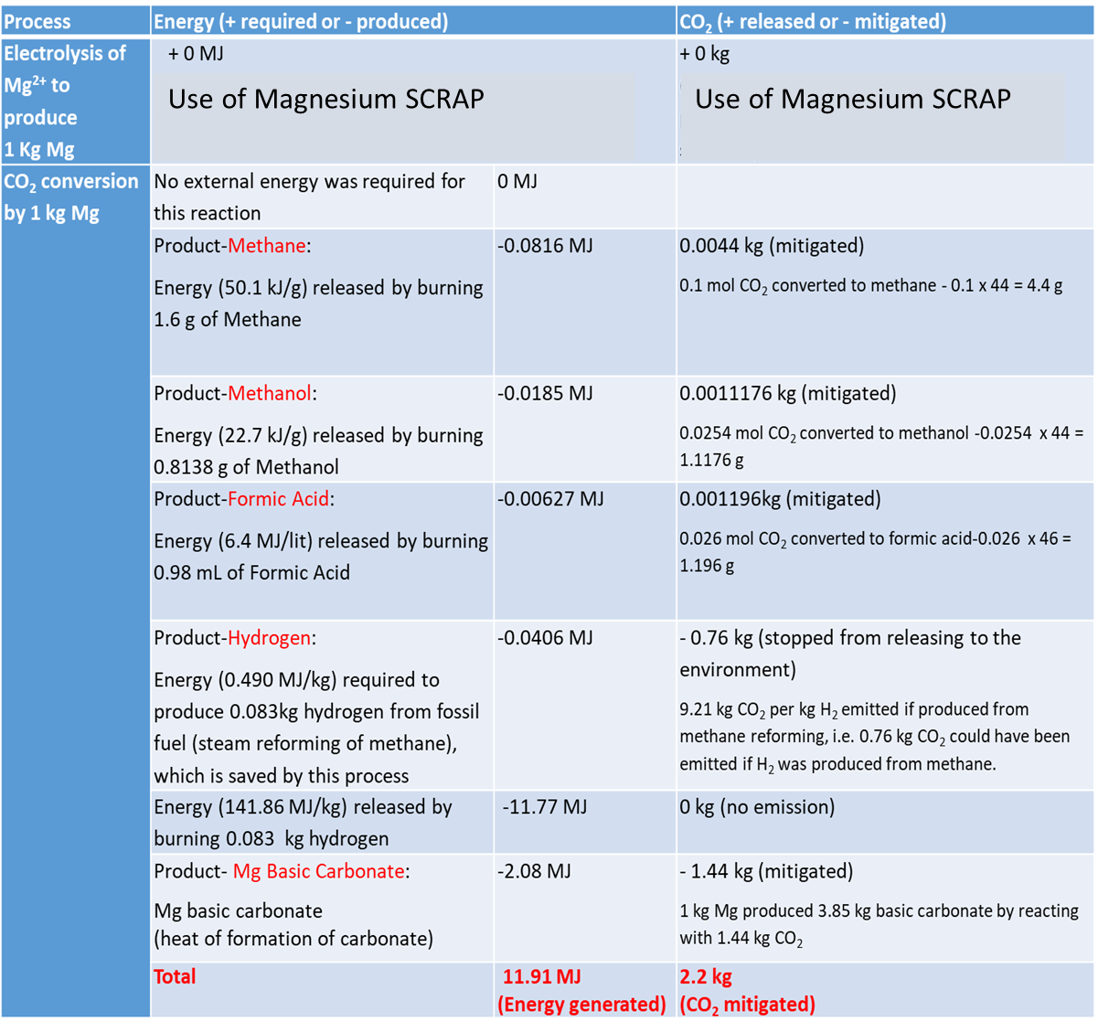
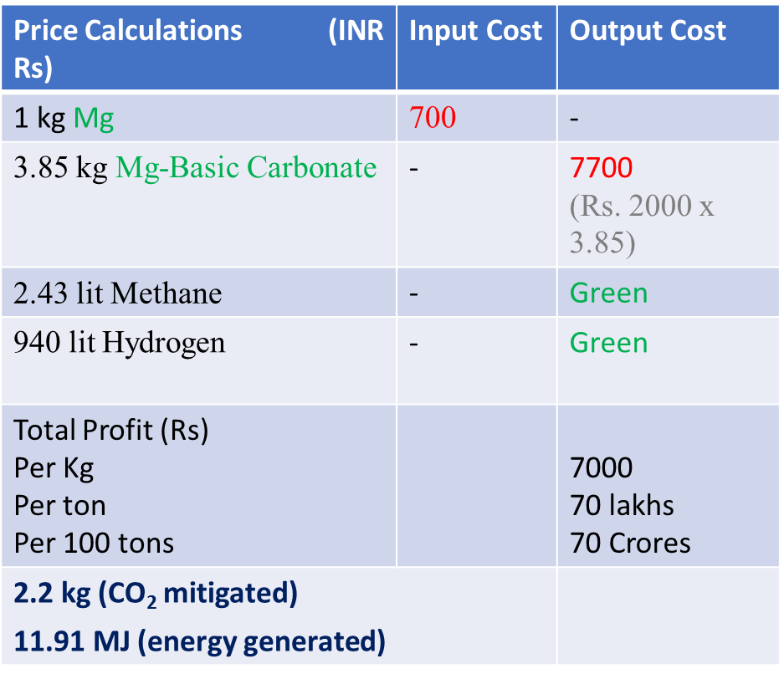
Transforming CO₂ and Sea Water to Green HYDROGEN & Green CEMENT Using Magnesium Waste Scrap
Rajesh Belgamwar, Sushma Rawool and Vivek Polshettiwar*
Department of Chemical Sciences, Tata Institute of Fundamental Research (TIFR), Mumbai, India
Email: rajesh.belgamwar@tifr.res.in, vivekpol@tifr.res.in
Infosys-TIFR Fellow
Introduction
Converting CO₂ directly from the air to fuel under ambient conditions is a huge challenge. Thus, there is an urgent need for CO₂ conversion protocols working at room temperature and atmospheric pressure, preferentially without any external energy input. Herein, we employ magnesium (nanoparticles and bulk), an inexpensive and the eighth-most abundant element, to convert CO₂ to methane, methanol and formic acid, using water as the sole hydrogen source. The conversion of CO₂ (pure, as well as directly from the air) took place within a few minutes at 300 K and 1 bar, and no external (thermal, photo, or electric) energy was required. Hydrogen was, however, the predominant product as the reaction of water with magnesium was favoured over the reaction of CO₂ and water with magnesium. During CO₂ conversion, Mg was converted to magnesium hydroxide and carbonate, which may be regenerated. Thus, even though the overall process is non-catalytic, it could serve as a step towards a sustainable CO₂ utilization strategy.^{[1]}
This poster is just a model for reference. Only external dimensions are fixed, and the internal layout, fonts (style, size, color), line spacing, and colors are flexible and as per the author's preferences.
Objective
CO₂ Reduction Experiment
How to convert CO₂ to fuel at room temperature and atmospheric pressure without any external energy?
CO₂ conversion was carried out by taking 50 mg of Mg in a batch reactor and then sealed with a rubber septum.
CO₂ gas was purged (50 mL min⁻¹) into the batch reactor for 30 min for optimum CO₂ adsorption on Mg surface.
Water was then injected into the reactor quickly in 20s under stirring, at room temperature and atmospheric pressure.
Reaction was initiated as soon as water was added.
The progress of the reaction was monitored by a online Micro GC.
Liquid products such as methanol and formic acid were identified and quantified by ¹H NMR spectroscopy
CO₂ +H₂O CH₄ + CH₃OH + HCOOH + H₂
A direct conversion of CO₂ to fuel,
at room temperature and atmospheric pressure
without the need for any external energy (no light, no electricity, no heat)
Just using water (no external hydrogen, even sea water works)
MAGNESIUM
(or air)
0 to 25°C
+ Mg-Basic Carbonate (Green Cement)
(Experimental setup for Mg-assisted CO₂ conversion.)
CO₂ Reduction: Kinetics, Productivity and Selectivity
Green Hydrogen Generation
Magnesium converted CO₂ (directly from the air or pure) at room temperature and pressure to methane, methanol, and formic acid, using water as the hydrogen source. No external energy (such as light, heat, or electricity) was required. The reaction was very fast, with a maximum product yield within 15 min.
This Mg protocol can even be used for H₂ production (940 liter per kg of Mg), which is nearly 420 times more than H₂ produced by the reaction of Mg with water alone (2.24 liter per kg of Mg)
(a) PXRD pattern (TEM image as inset) of Mg.
(b, c) Methane yield as a function of reaction time for CO₂ reduction by Mg NPs using, CO₂ directly from the air and pure CO₂
(d) Comparison of productivity of various metals and Mg–metal alloys.
(e) methanol, formic acid, and methane yields after 1h.
(f) methane, methanol, and formic acid yield quantified after 1, 5, and 15 min of CO₂ reduction on Mg
“Green Hydrogen on Demand”
H₂O
CO₂
Hydrogen
Hydrogen yield with reaction time during CO₂ reduction at room temperature and atmospheric pressure using water.
Portable Magnesium Cartridge which will produce H₂ from Water and CO₂ at Room Temperature and Atmospheric Pressure
Plausible Reaction Mechanism of CO₂ Conversion
Process Sustainability
Economics of the Process
Life-Cycle Assessment (LCA)
1 kg of Mg via simple reaction with water and CO₂ produces in 1 hr,
Methane (2.43 lit),
Hydrogen (940 lit),
Mg-basic carbonate (3.85 kg),
Small amount of methanol, formic acid
*Preliminary (not comprehensive)
Reaction mechanism of CO₂ conversion to methane, methanol, and formic acid by Mg using water.
(a) ¹³C NMR spectrum of the reaction mixture (using labeled ¹³CO₂) after 1 h of reaction of ¹³CO₂ with Mg; (b) FTIR spectra, (c) PXRD patterns and (d) XPS C 1s spectra of solid products recovered after 1, 5, and 15 min of the reaction of CO₂ with Mg
Conclusions
Acknowledgement
CO₂ (directly from the air or pure) was converted by magnesium (even scrap Mg) at room temperature and atmospheric pressure to methane, methanol, and formic acid, using water as the hydrogen source.
No external energy (such as light, heat, or electricity) was required.
The reaction was very fast, with a maximum product yield within 15 min.
This process produces 3.85 kg of green cement by mitigating 2.2 kg of CO₂.
1 kg of Mg can produce 940 litres of green hydrogen, which is nearly 420 times more than the hydrogen produced by the reaction of Mg without CO₂ (2.24 litre per kg of Mg).
We thank Infosys-TIFR for the travel grant. We also thank the Department of Atomic Energy, Government of India, and SHELL industries for funding.
References:
S. A. Rawool, R. Belgamwar, R. Jana, A. Maity, A. Bhumla, N. Yigit, A. Datta, G. Rupprechter and V. Polshettiwar. Chem. Sci., 2021,12,5774.

